Slide 1
Automated Surveillance
Anupam Guha

Slide 2
AI Surveillance is expanding
AI surveillance technology is spreading at a faster rate to a wider range of countries than experts have commonly understood. At least seventy-five out of 176 countries globally are actively using AI technologies for surveillance purposes. This includes: smart city/safe city platforms (fifty-six countries), facial recognition systems (sixty-four countries), and smart policing (fifty-two countries).

Slide 3
China is a major driver of AI surveillance worldwide
Technology linked to Chinese companies—particularly Huawei, Hikvision, Dahua, and ZTE—supply AI surveillance technology in sixty-three countries, thirty-six of which have signed onto China’s Belt and Road Initiative (BRI). Huawei alone is responsible for providing AI surveillance technology to at least fifty countries worldwide. No other company comes close. The next largest non-Chinese supplier of AI surveillance tech is Japan’s NEC Corporation (fourteen countries).

Slide 4
Soft loans?
Chinese product pitches are often accompanied by soft loans to encourage governments to purchase their equipment. These tactics are particularly relevant in countries like Kenya, Laos, Mongolia, Uganda, and Uzbekistan—which otherwise might not access this technology. This raises troubling questions about the extent to which the Chinese government is subsidizing the purchase of advanced repressive technology.

Slide 5
What of USA?
I surveillance technology supplied by U.S. firms is present in thirty-two countries. The most significant U.S. companies are IBM (eleven countries), Palantir (nine countries), and Cisco (six countries). Other companies based in liberal democracies—France, Germany, Israel, Japan—are also playing important roles in proliferating this technology. Democracies are not taking adequate steps to monitor and control the spread of sophisticated technologies linked to a range of violations.

Slide 6
Liberal democracies?
Liberal democracies are major users of AI surveillance. The index shows that 51 percent of advanced democracies deploy AI surveillance systems. In contrast, 37 percent of closed autocratic states, 41 percent of electoral autocratic/competitive autocratic states, and 41 percent of electoral democracies/illiberal democracies deploy AI surveillance technology.¹ Governments in full democracies are deploying a range of surveillance technology, from safe city platforms to facial recognition cameras. This does not inevitably mean that democracies are abusing these systems. The most important factor determining whether governments will deploy this technology for repressive purposes is the quality of their governance.

Slide 7
Autocracies
Governments in autocratic and semi-autocratic countries are more prone to abuse AI surveillance than governments in liberal democracies. Some autocratic governments—for example, China, Russia, Saudi Arabia—are exploiting AI technology for mass surveillance purposes. Other governments with dismal human rights records are exploiting AI surveillance in more limited ways to reinforce repression. Yet all political contexts run the risk of unlawfully exploiting AI surveillance technology to obtain certain political objectives.

Slide 8
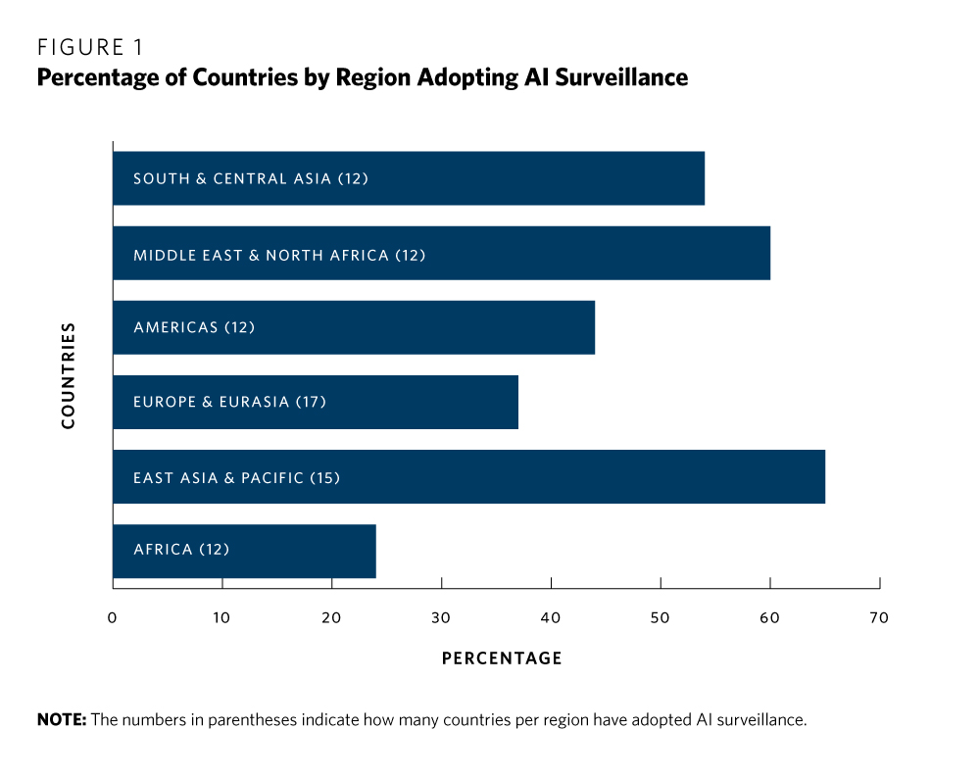

Slide 9
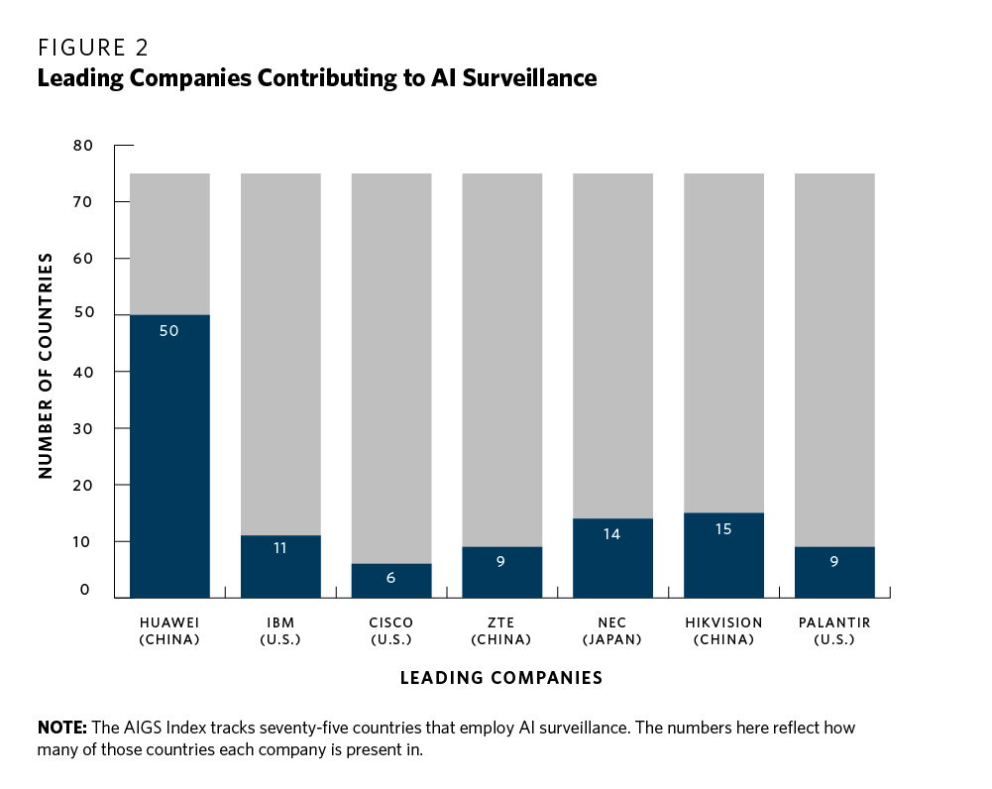

Slide 10
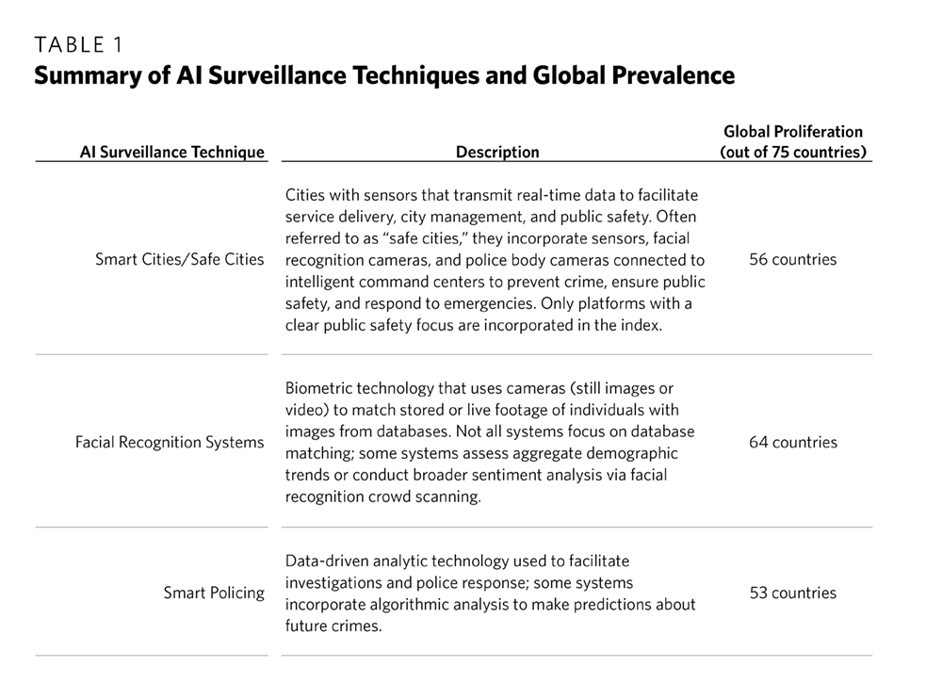

Slide 11
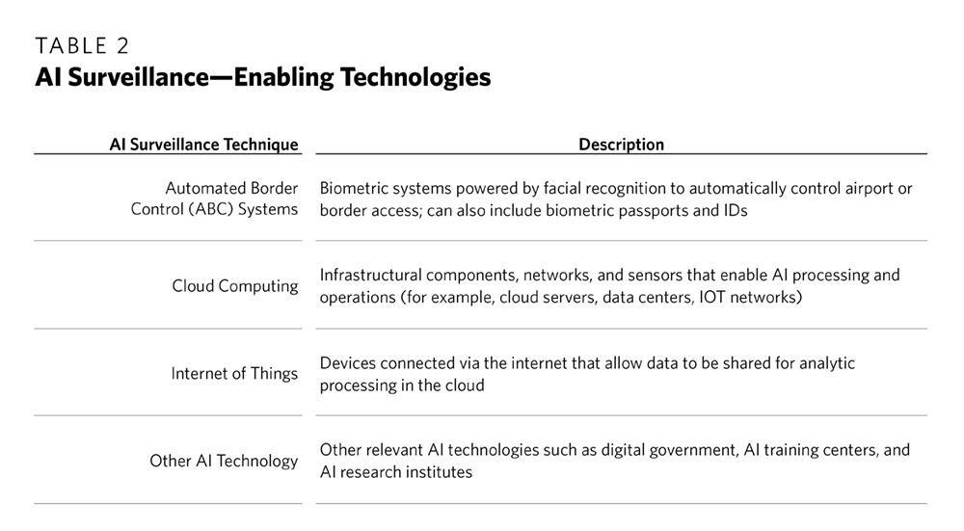

Slide 12
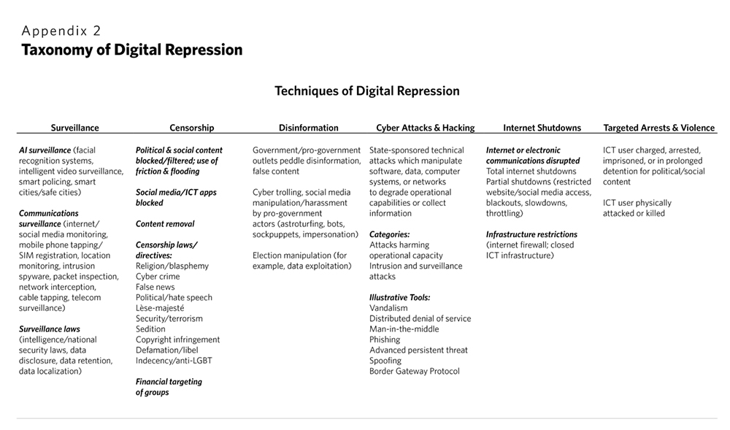

Slide 13
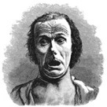
The Expression of the Emotions in Man and Animals, Charles Darwin, 1872

Slide 14
Physiognomy - study of the underlying skeletal structure
Pathognomy - study of the face’s mobile expressivity
So, can we read faces?
Darwin’s ideas have served to release humanity from one form of determinism only to encase it in another. It exchanges the determining framework of facial morphology for a set repertoire of purportedly hard-coded affect programs rooted in our evolutionary inheritance. - Richard Woodall, Lying Eyes

Slide 15
Discussion

